Slide 1
Rainbow room
SOLUTION PRESENTATION – VIDEO CONFERENCING
April 2020

Slide 2







Market trends
The rise in remote working requires you to offer technologies that cater to the needs of today’s flexible workforce
80% of job-seekers stated that when faced with two similar offers, they would turn down the one that didn’t offer flexible working
85% of employers confirm that productivity has increased as a result of greater flexibility
50% of employees globally are working outside of their offices for at least 2.5 days a week
(Source: IWG,2019)

Slide 3




Customer concerns
However, many businesses struggle to find the video conference solution that is right for them
Lack of standards: Which solution will take into account my individual requirements (budget, conference room specifics, quality, openness etc.)?
Faulty infrastructure: Does the vendor have a stable and trusted network that will ensure an extremely low-level of downtime that could impact my business?
People using it incorrectly: Good intentions aside, if people aren’t trained on how to use a new technology, chances are they will use it incorrectly…

Slide 4
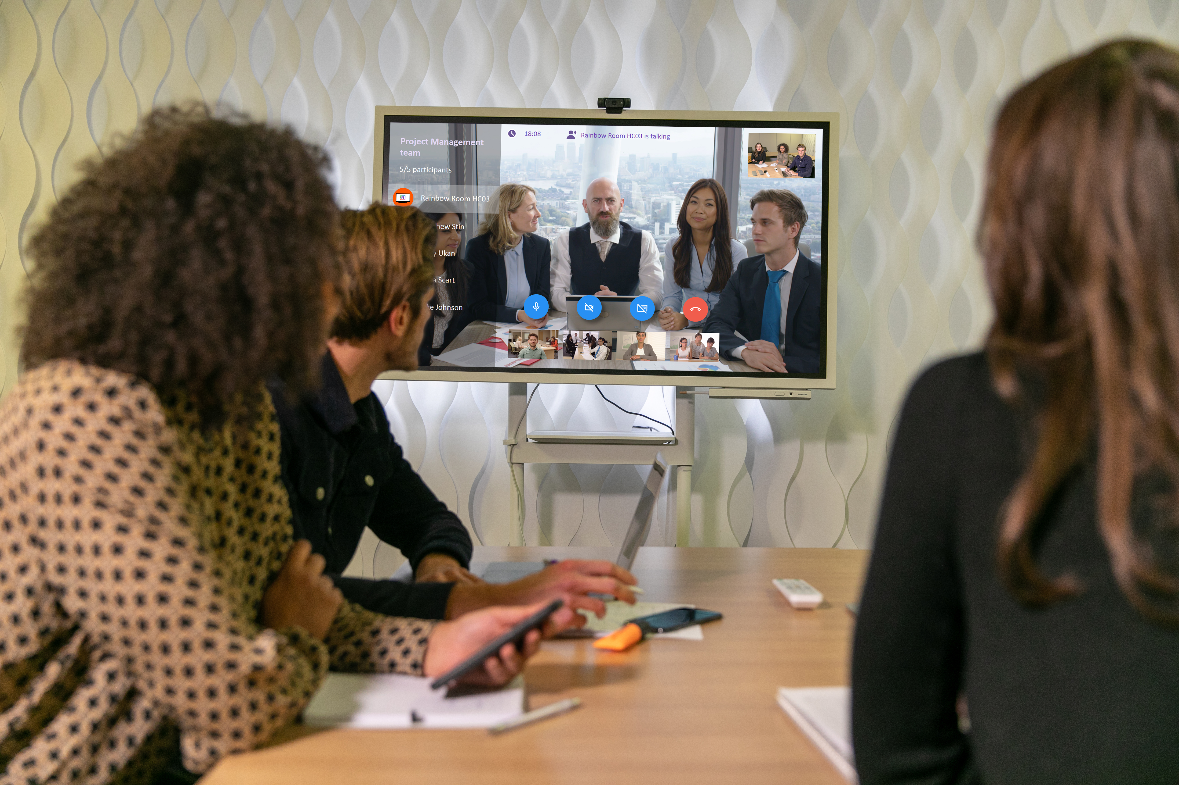




Alcatel-lucent enterprise
RAINBOW ROOM
ONE-CLICK VIDEO MEETING
INTUITIVE USER INTERFACE
HIGH DEFINITION VIDEO
COST EFFECTIVE AND FLEXIBLE

Slide 5
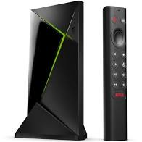

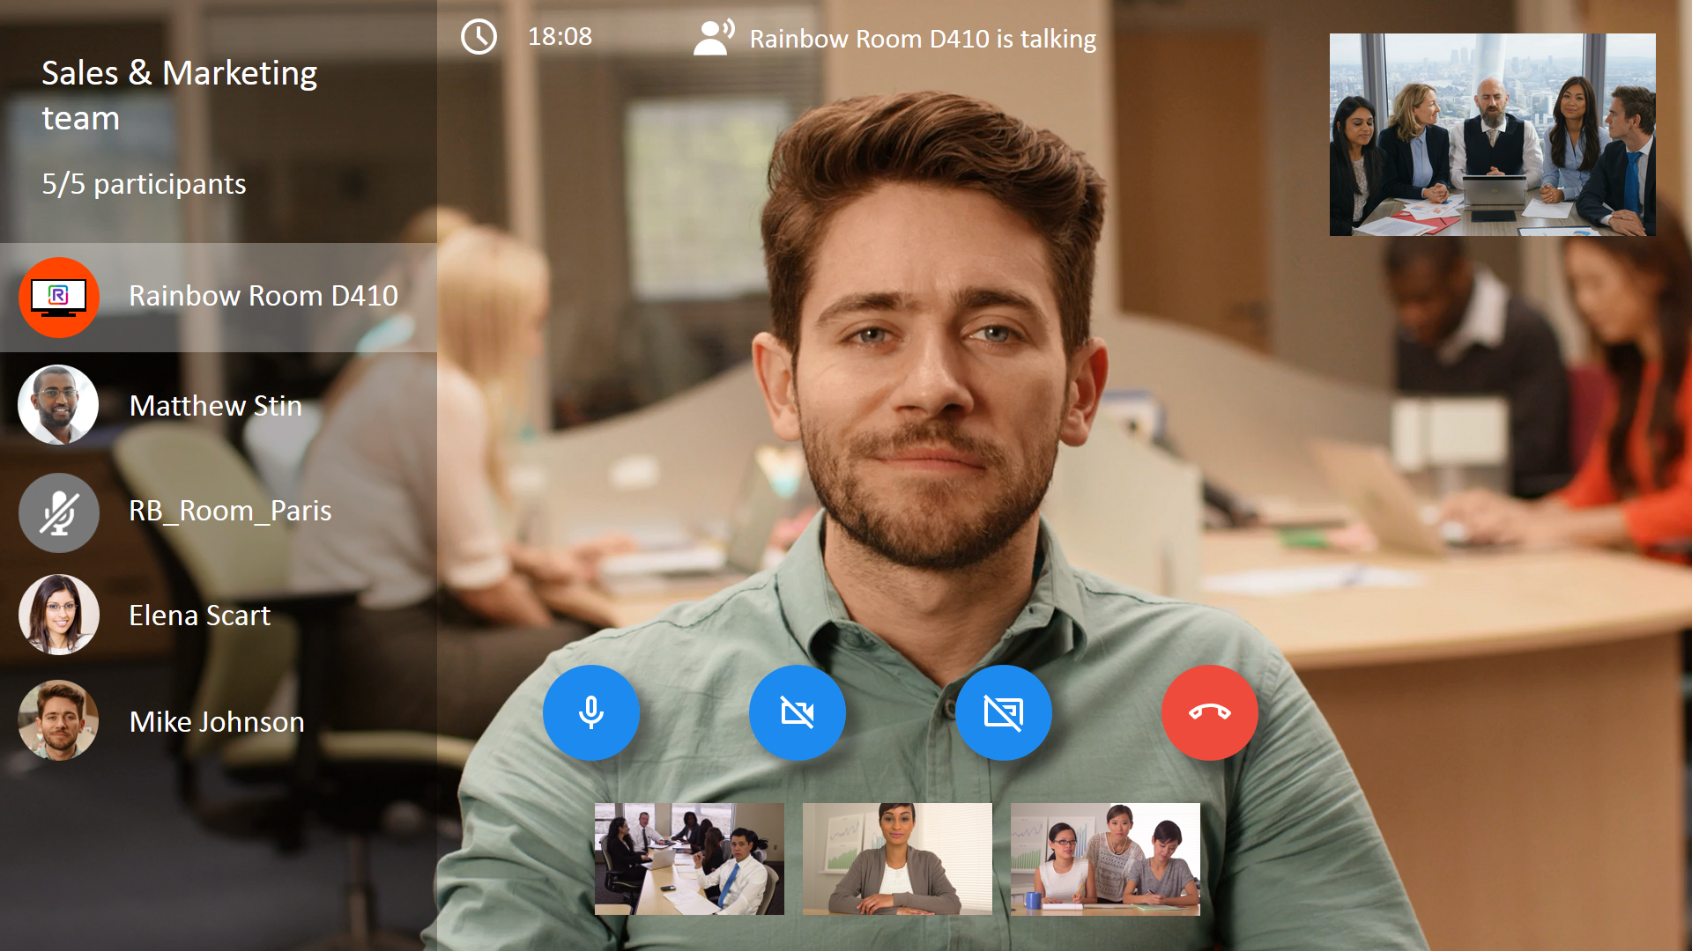
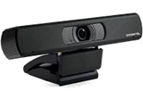
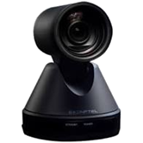
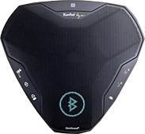
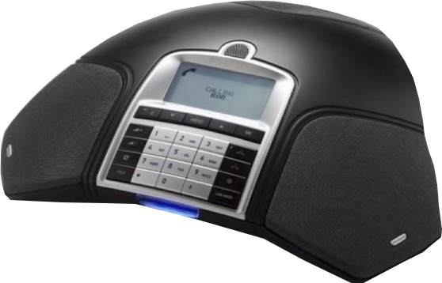
RAINBOW ROOM
Direct meeting from one Rainbow Room to another
Android TV box
Invite a Rainbow Room into your Bubble as any Rainbow contact
+ Hardware kits
Huddle Room kit
Meeting Room kit
On-line meetings from a conference room
Monitor
Reach mobile users or external contacts from any conference room
“Rainbow Room”
Subscription
Konftel CAM20
Konftel CAM50
Alcatel-Lucent EGO
Personal Speakerphone
Alcatel-Lucent 8135S
IP Conference Phone
Notes:
Rainbow Room is a new subscription in the Rainbow UCaaS Offer to connect meeting room equipment to the Rainbow cloud.
It is based on an Android TV box, easily connected to any screen monitor via HDMI, a compatible camera and a speaker/microphone device.
Hardware kits are available in ALE catalog for camera and a speaker/microphone devices.
Any user with a Rainbow account (ESSENTIAL, BUSINESS, ENT/ENT.CONF) can invite a Rainbow Room into a Rainbow bubble.
It’s visible as a contact in the corporate directory into a Rainbow Bubble. Then start a meeting with audio, video, screen sharing (based on WebRTC standard) with the other participants of the meeting.
It is a perfect solution for on-line meetings from a conference room.
Rainbow Room enables on-site employees in the conference room to meet on-line with mobile users or external contacts.

Slide 6


SIMPLE Use cases #1
Room to room direct video call
Office A
Office B

Slide 7

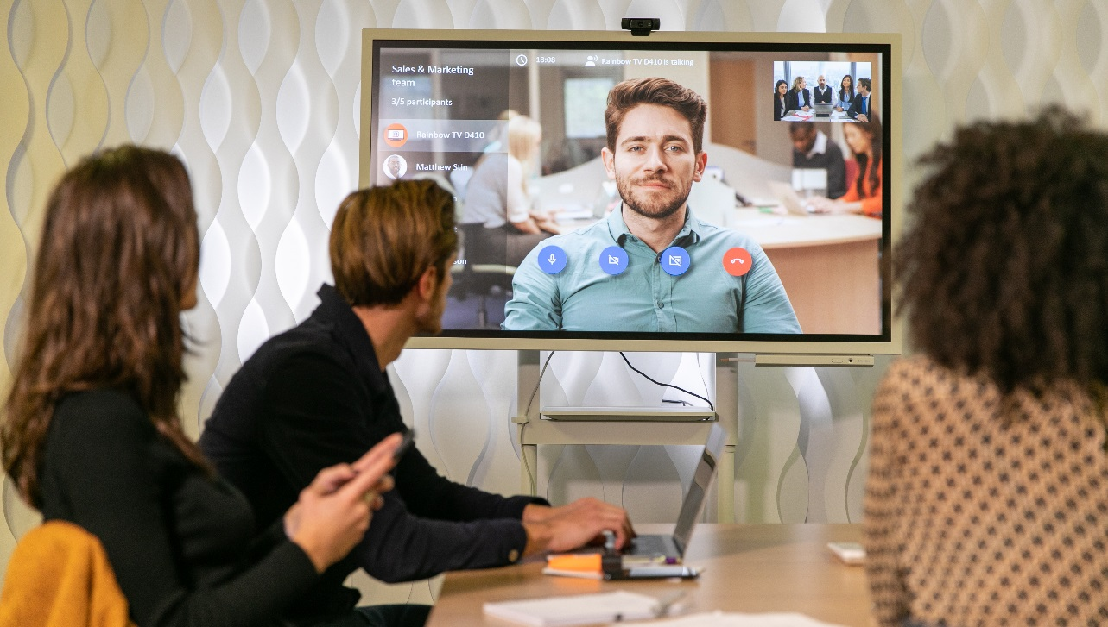


SIMPLE Use cases #2
Video conference with internal and external people in a Rainbow Bubble
Location A
Meeting room in one of the company’s office
Location D
External contractor or customer invited to the video conference (invitation by email, URL link to connect on compatible web browser)
Location B
One of your employees connected from his smartphone (with the Rainbow mobile app Android or iOS)
Location C
Another meeting room in a distant company’s office

Slide 8
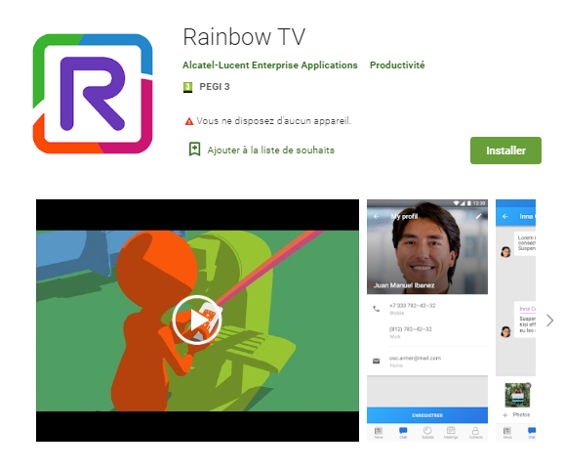
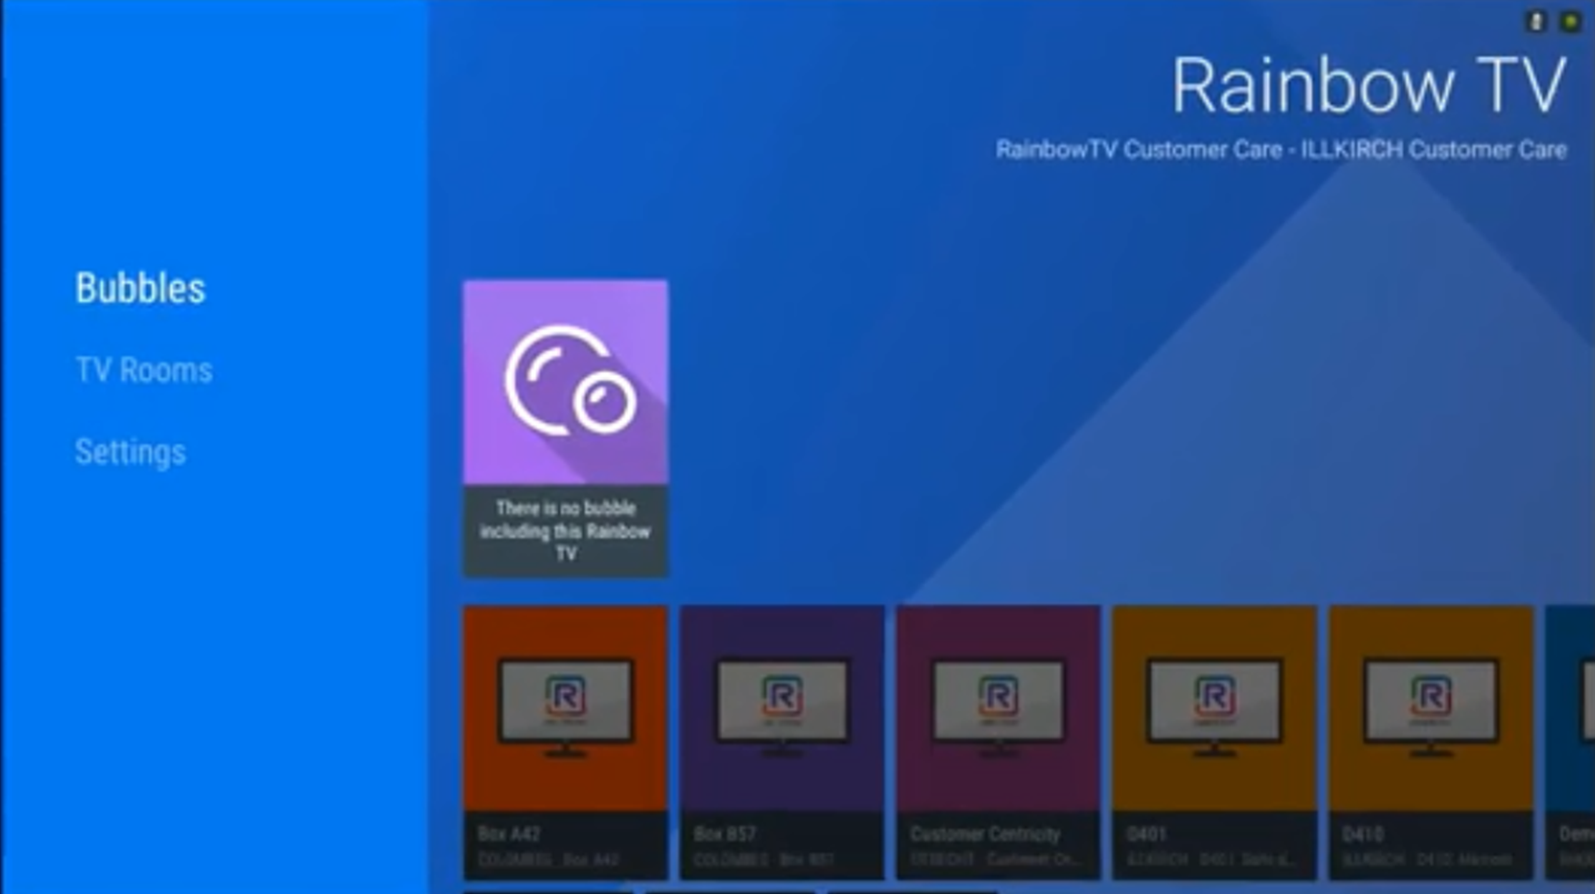
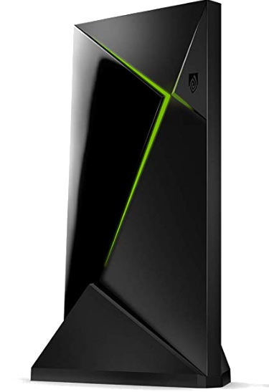


Solution blueprint
Rainbow Room application, available on the Google Play Store
HTTPS
Camera
Internet access
LAN
Monitor
USB
USB
Rainbow Room is a specific Rainbow account
Speakerphone
Android TV box

Slide 9
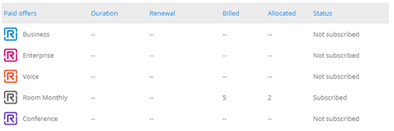


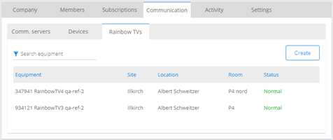

subscription
Use the Rainbow admin panel that lets you autonomously manage your Rainbow Room subscription(s):
PSTN access through peering with selected Service Providers (common trunk for all customers of a SP)
Purchase Rainbow Room service plans via the normal Rainbow administrative portal
Create a Rainbow Room and get an activation code
Enter activation code during the first launch of the Rainbow Room application

Slide 10





RAINBOW OFFER pricing
World price listing (WPL)
Service Plan | Unit | Terms & Billing | Monthly fees (WPL) | Availability*
Essential | Per user | Freemium | €0.00 | Available
Business | Per user | 1M or prepaid 1Y/3Y/5Y | €2.00 | Available
Enterprise | Per user | 1M or prepaid 1Y/3Y/5Y | €4.00 | Available
Enterprise Conference | Per leader | prepaid 1Y | €19.00 | Available
Room | Per room | 1M or prepaid 1Y/3Y/5Y | €19.00 | APRIL 2020
>> Refer to the Rainbow UCaaS Price List for more details (EUR USD)
Notes:
Rainbow Room is dedicated to physical meeting rooms (huddle or large), meaning a shared equipment for all employees at the office.
Any employee (without any individual user subscription) can use it for room to room video conference.
Any Rainbow user, including a ESSENTIAL freemium user or a BUSINESS premium user, in the company can add the Rainbow Room into a bubble he has created and start the video meeting from the meeting room.
There is a specific app installed into the Android TV box that is completely different from the standard Rainbow app on android for a user.

Slide 11
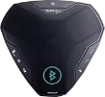
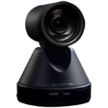

Hardware kits
Available in the ALE MLE and SMB catalogs from April 2020*:
3MG07083AA | RAINBOW HUDDLE ROOM KIT (EGO + CAM20)
3MG07084AA | RAINBOW MEETING ROOM KIT (8135S + CAM50)
Konftel CAM20
Alcatel-Lucent EGO
PERSONAL SPEAKERPHONE
Konftel CAM50
Alcatel-Lucent 8135S
IP CONFERENCE PHONE
* Refer to the ALE catalog and Price List documents for country availability and pricing information
A white list will be published for audio and video equipment
The Android TV box must be purchased separately. The box is not delivered by Alcatel-Lucent Enterprise. Compatible hardware list (refer to the Feature List official document on Rainbow Help Center web site):
  Nvidia Shield TV
  Nvidia Shield TV PRO
Notes:
Available in the ALE MLE and SMB catalogs from April 2020:
Rainbow Huddle Room Kit with Konftel CAM20 and the Alcatel-Lucent EGO PERSONAL SPEAKERPHONE.
Rainbow Meeting Room Kit with Konftel CAM50 and the Alcatel-Lucent 8135s IP Conference Phone.
A white list will also be published for audio and video equipment, tested, validated and supported.
Hardware kits described in the slide can be ordered with the ACTIS quotation tool.
Please note that the Android Box is not included in the ALE catalog.
You can find the reference and the technical requirements on the slide.

Slide 12
Installation meeting room
Camera
USB
Monitor
USB
Speakerphone
Android TV box
LAN

Slide 13
RAINBOW HUDDLE ROOM KIT
Konftel CAM20
Monitor
USB
USB
Alcatel-Lucent EGO
PERSONAL SPEAKERPHONE
Android TV box
LAN

Slide 14
RAINBOW MEETING ROOM KIT
Konftel CAM50
Monitor
USB
USB
Alcatel-Lucent 8135S
IP CONFERENCE PHONE
Android TV box
LAN
Optionally connected to the ALE OmniPCX IP PBX to allow 2nd call and audio three-party conference with the participants of the Rainbow video conference

Slide 15
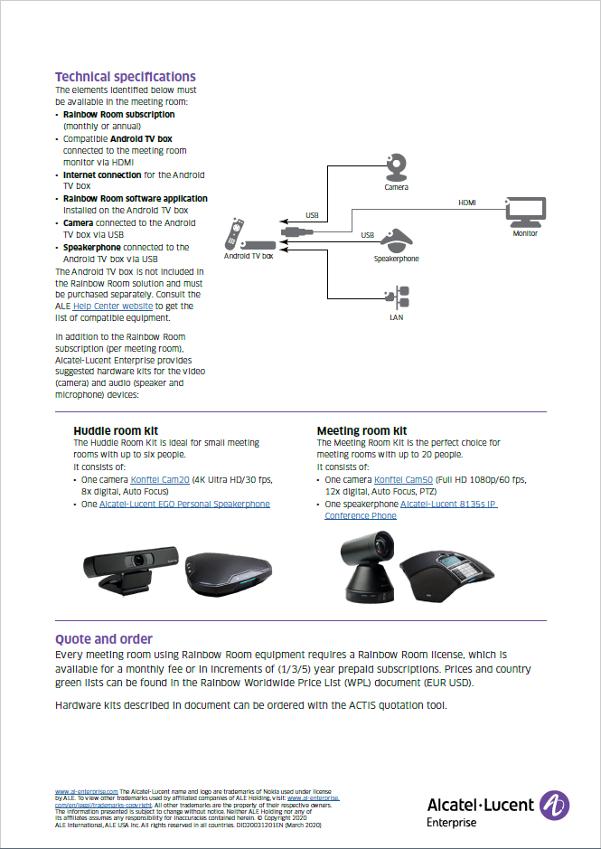
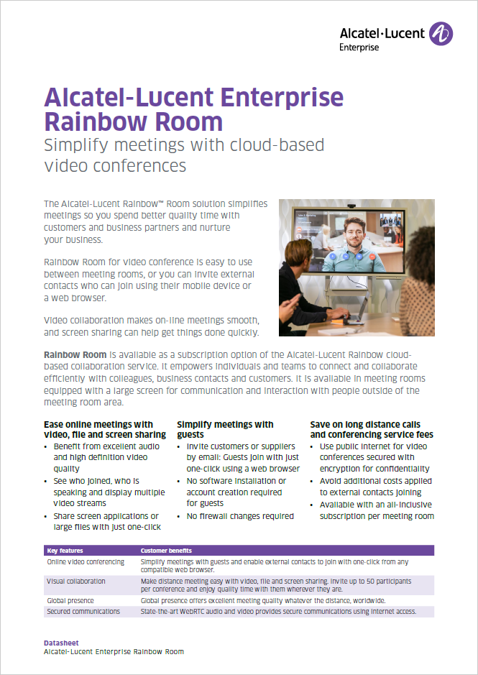
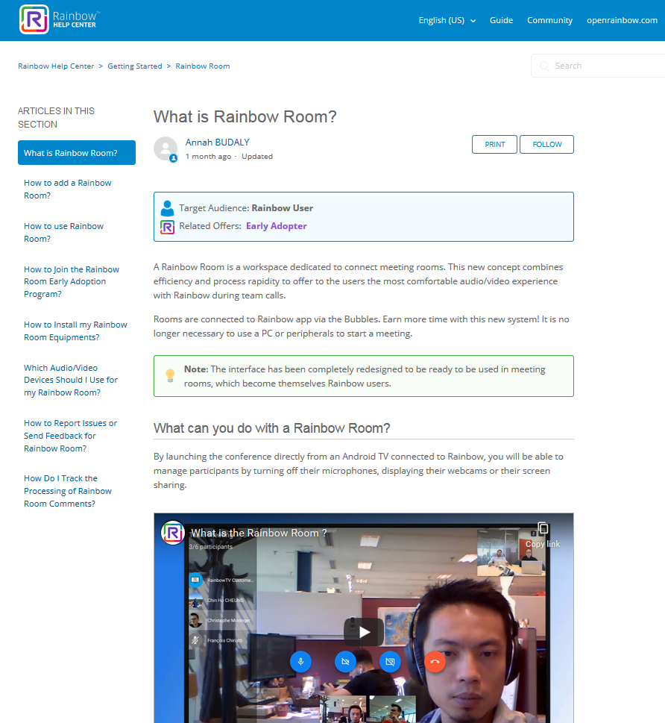
GET STARTED
Solution datasheet (EN FR DE ES)
Visit our Help Center and get started with Rainbow Room:
  Videos
  Installation guidance
  User Guide

Slide 16


Rainbow room
Alcatel-Lucent Enterprise cloud solution for simple video conferences
Lack of standards: Which solution will take into account my individual requirements (budget, conference room specifics, quality, openness etc.)?
Available at an extremely affordable rate, Rainbow Room co-exists with your existing ALE telephony infrastructure, saving you both time and money
Faulty infrastructure: Does the vendor have a stable and trusted network that will ensure an extremely low-level of downtime that could impact my business?
With an uptime of 99.86%, the Rainbow cloud infrastructure serves more than 1.7 millions users in over 199 countries and has facilitated over 120 Million WebRTC minutes
People using it incorrectly: Good intentions aside, if people aren’t trained on how to use a new technology, chances are they will use it incorrectly…
In addition to the extremely friendly user-interface, both the ALE Customer Care team and our global network of partners are always at hand to help train and educate users on how to make the most of their new conferencing solution

Slide 17




CONTACTUS
WEBSITE
www.al-enterprise.com
Follow us on:
The Alcatel-Lucent name and logo are trademarks of Nokia used under license by ALE.

